Slide 1
Types Of Interviews
Job Support 4 U

Slide 2
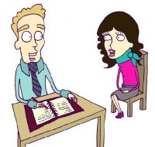
Screening Interview
These are used to ensure candidates meet minimum requirements. Companies use these when they have large amount of applicants!
Tips
Highlight your qualifications/accomplishments
Answer questions clearly
If done by phone, have your CV/application at hand

Slide 3
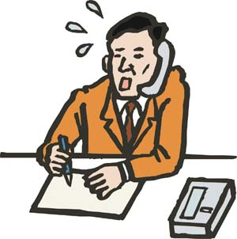
Telephone Interview
Cost effective method to screen applicants. Challenging interview as you can’t rely on non verbal communication or body language!
Tips
Have all information at hand CV etc.
Have & take notes
Have a glass of water at hand
Be in a quiet environment
Speak clearly & slow
Stay relaxed

Slide 4
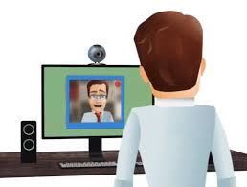
Video Interview
Growing in popularity due to Skype. Treat it like a normal face to face interview. Appearance & body language are important!
Tips
Check all equipment at home beforehand
At home make sure environment in background is presentable
Make eye contact with web camera
Don’t panic if delay in responses. Stay professional.

Slide 5
One To One Interview
Most common interview format. Interview is by the employer or HR representative. Body language & appearance important factors!
Tips
Preparation beforehand is key
Prepare to answer & ask questions
Relax, smile & be yourself

Slide 6
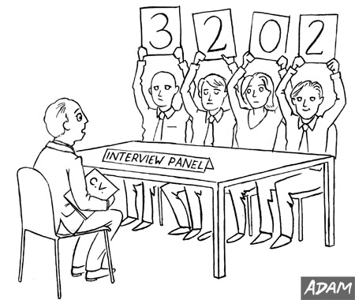
Panel Interview
Interview done by two or more interviewers. Questions can be asked by one person or in turns!
Tips
Preparation is key
Stay calm & alert
Focus on who asking you questions but also keep eye contact with all when answering

Slide 7
Group Interview
Interview with other candidates, were you be asked to interact with each other by group discussion or group task!
Tips
Treat everyone with respect & avoid power struggles
All interactions are observed, stay focused
Know what interviewer wants to see from the tasks

Slide 8
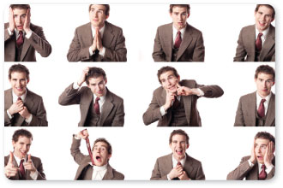
Sequential Interview
Interviews that are one after another conducted by different interviewers. You are scored in ever interview with the group of interviewers agreeing who scored best!
Tips
First impressions count in each interview
Answer all questions even if you been asked same on in another interview

Slide 9
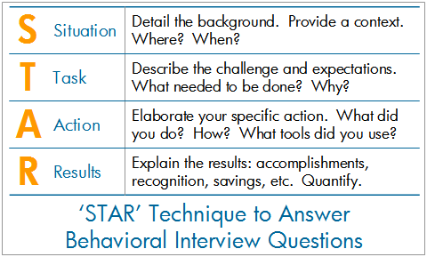
Behavioural Interviews
Interviewers will ask for examples for your past experiences to provide evidence of your skill in certain tasks/areas. They assessing your skills & how you handle situations in the role!
Tips
Have examples of your skills ready
Structure you answer – use the STAR technique
Don’t waffle

Slide 10
Informal Interview
An interview that is more relaxed and friendly. Can seem like a chat than an interview!
Tips
Don’t dress down too much
Still prepare like you would for an formal interview
You’re still being assessed

Slide 11
Second Interview
You’ve impressed enough in your first interview to be selected for a second & usually final one. Selection process is now from a smaller group of candidates!
Tips
Prepare like it your first interview again
Review your last interview performance
Review/Research company more
Answer questions that you have already been asked in first interview

